Slide 1
Handling Secrets
Technical overview
Robert Gemrot
Metio Software s.r.o.
Bet you can‘t read this

Slide 2
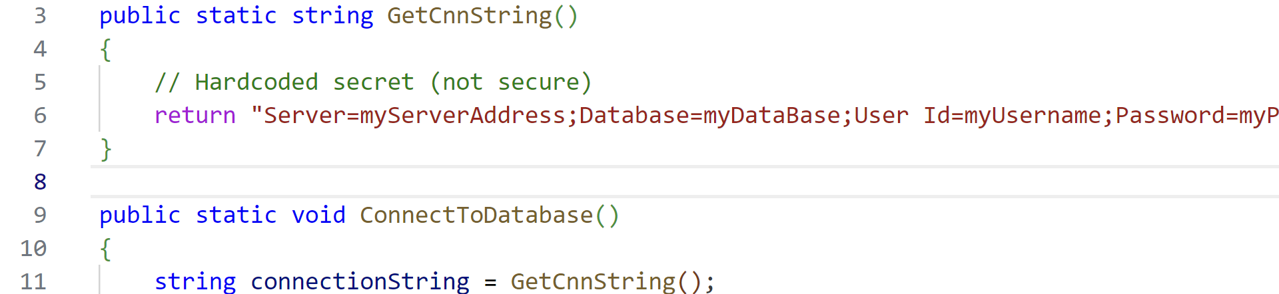
Secrets are everywhere…
User accounts
Not our focus
Authentication between services
Connecting to DB
Dangerous if done incorrectly
Hard-coding

Slide 3
Theory: where to get secrets
Environment variables
Files („mounts“)
Network calls
Other methods not discussed
Specialized hardware
„let‘s measure the CPU load and transform the percentages to letters“

Slide 4
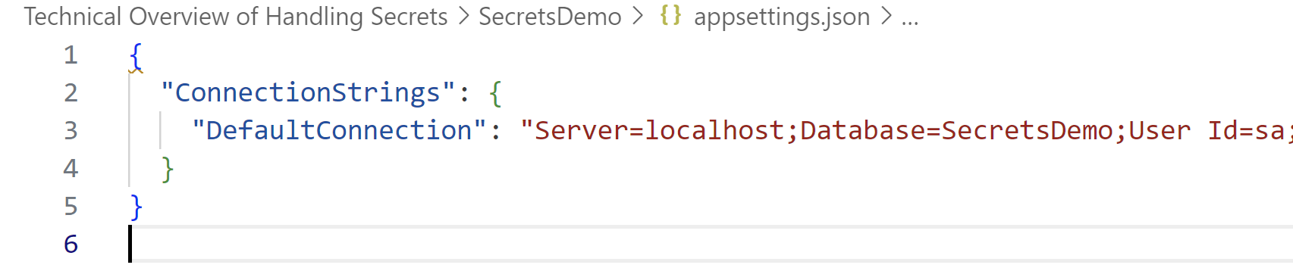
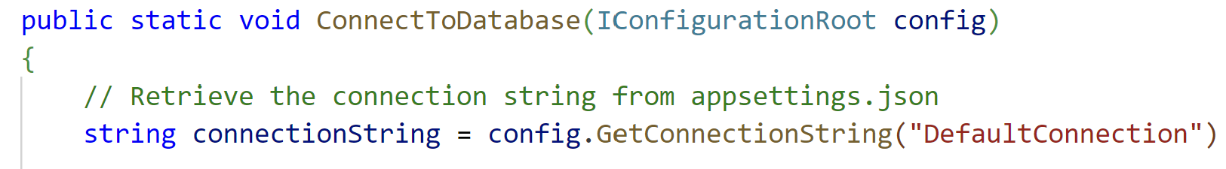
Manual deploy
DEMO: appsettings.json
Practicality (files > envvars)

Slide 5
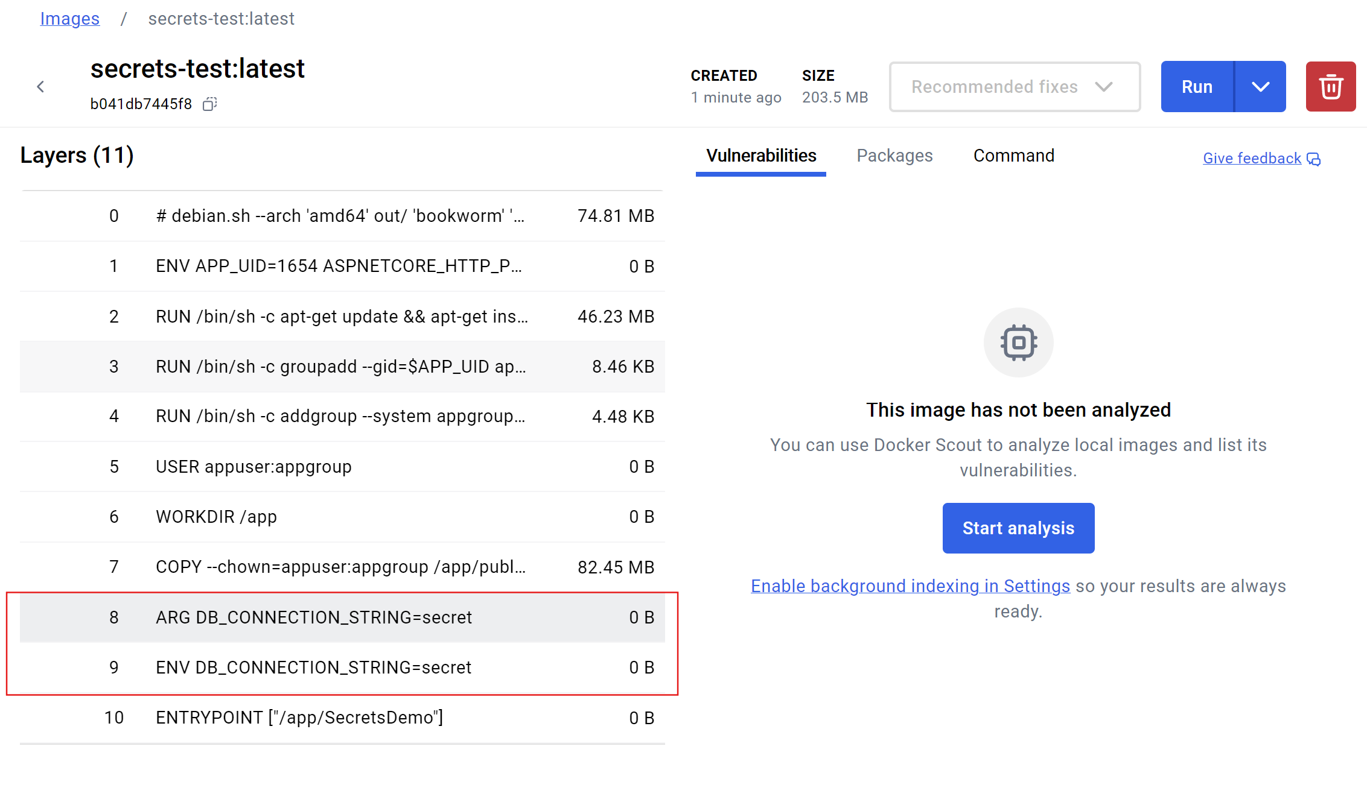
Single Docker image
Build time
Run time
Why?
Hosting in the cloud
Docker build-time secrets are something else and perfectly OK

Slide 6
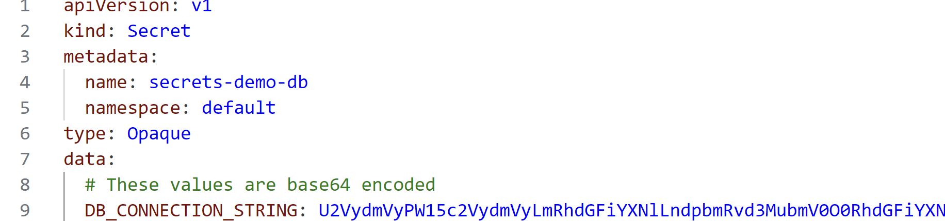
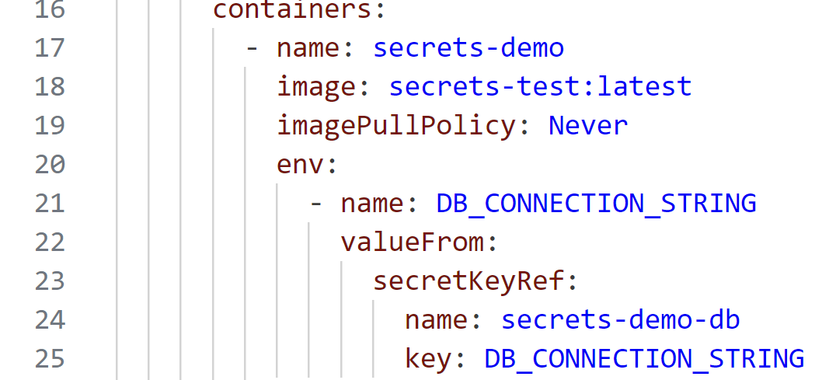
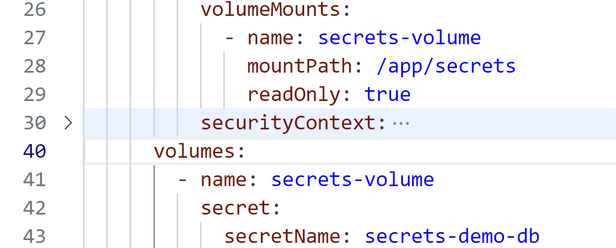
Kubernetes: The Secret object
DEMO
As env. var
As volume

Slide 7
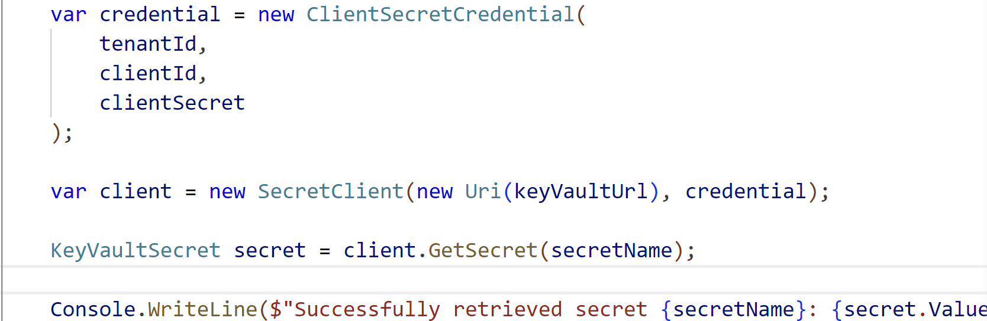
Key Vaults
Network calls
Need to authenticate
DEMO – C# and Powershell

Slide 8
Passwordless: Managed Identity
Delegates handling secrets to Cloud provider(s)
DEMO

Slide 9

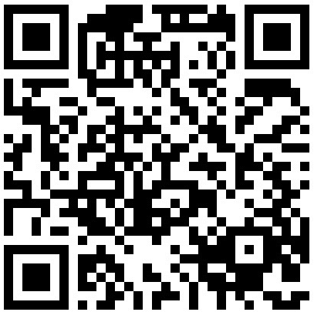
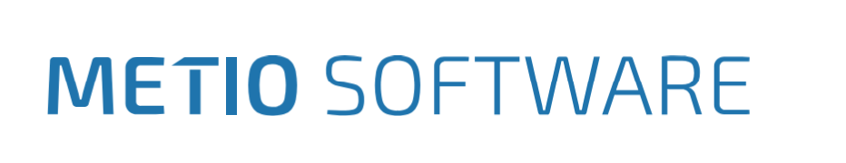
Robert Gemrot
Metio Software s.r.o.
github.com/fejbl2/lectures
linkedin.com/in/robert-gemrot

